Slide 1
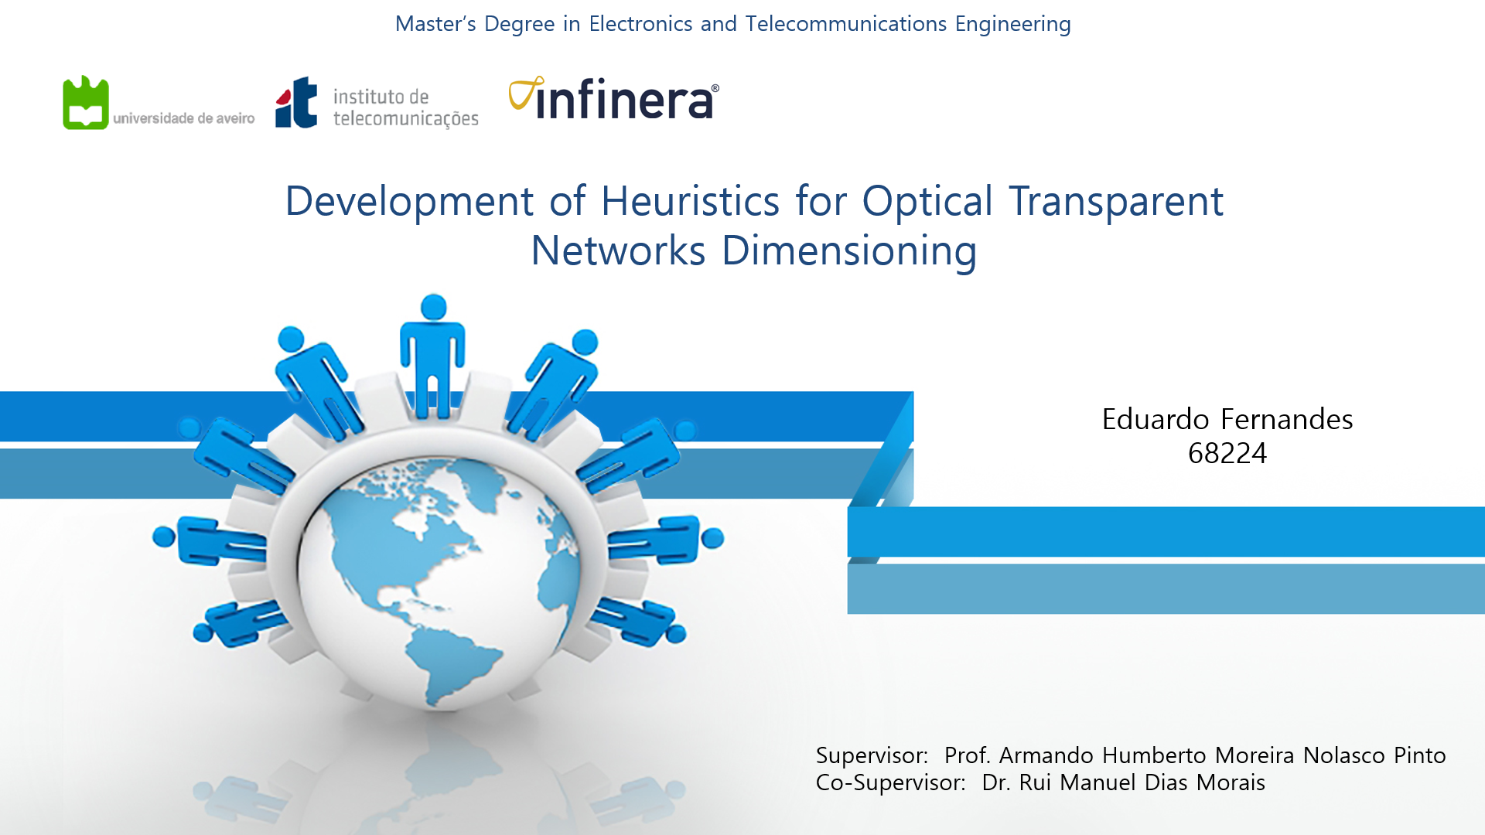

Slide 2
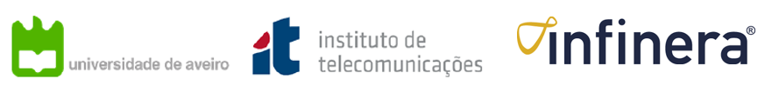
Motivation
Development of Heuristics for Optical Transparent Networks Dimensioning
The crucial premise for network operators to choose the technology and architecture to deploy is the cost minimization.
The cost factor is therefore a major issue in the telecommunication industry and tend to have a strong influence in all engineering decisions.
It is extreme difficult to make a fast and scalable planning to an optical network by hand.
Planning tools directly affect the competitiveness of system vendors and network operators.
Notes:
O principal objetivo dos operadores de rede é a escolha e a implementação de tecnologias que permitam minizar os custos envolvidos nas operações. O factor de custo é portanto factor decisivo na área das telecomunicações tendo influência em todas as decisões quer administrativas quer também ao nível da engenharia. De modo a poder simplificar este processo de dimensiomento de redes vários esforços têm sido levados a cabo tanto por empresas particulares como em ambiente académico para desenvolver ferramentas de planeamento, pois para redes maiores este processo torna-se demasiado complexo e demoroso para ser feito manualmente. Apesar de já existirem algumas ferramentas comerciais, tipicamente elas contêm informação e tecnologia proprietária às empresas que não é divulgada para efeitos de estudos e comparações. Nesse âmbito surgiu a possibilidade de criar a ferramenta proposta nesta dissertação, para efeitos puramente académicos.

Slide 3
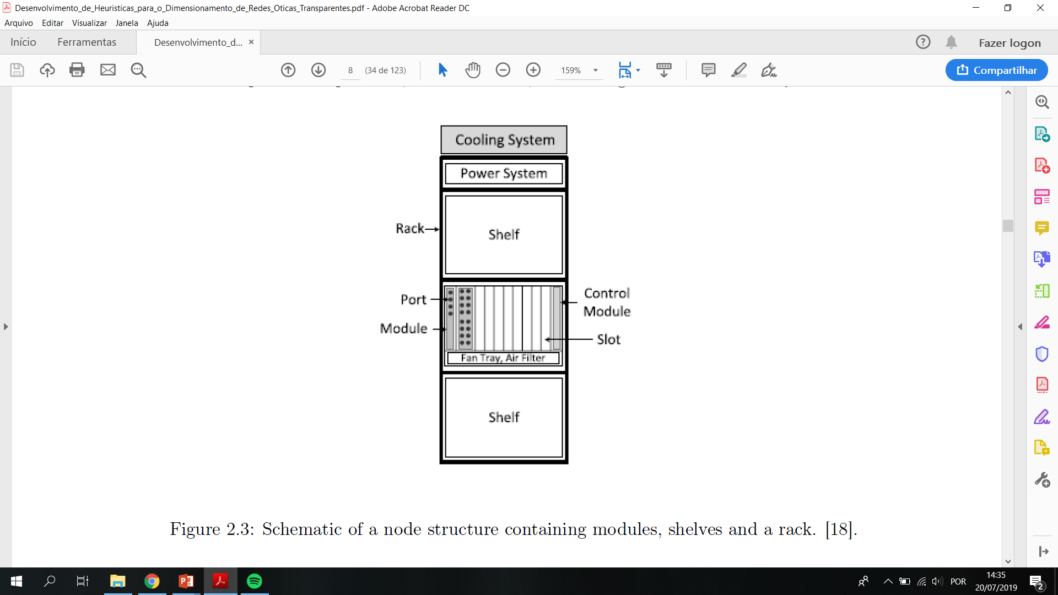
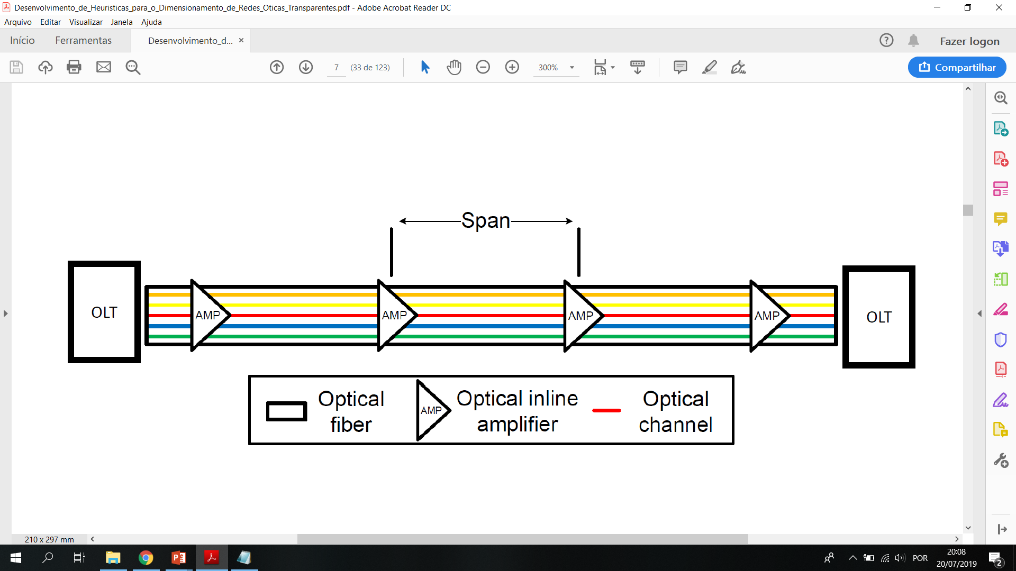
Network Architecture
Development of Heuristics for Optical Transparent Networks Dimensioning
Notes:
An optical transport network can be seen as set of bidirectional links connecting nodes.
LINKS: Physical point-to-point connections between adjacent nodes ensured by transmission systems, thus guaranteeing the transmission of WDM signals between them. Links can be composed by one or more transmission systems where each one usually comprises one pair of unidirectional optical fibers ensuring a bidirectional connection between the nodes. In networks capable of allowing the transiting traffic to remain in the optical domain, as it is the case, it must be considered another important property of the transmission systems which is the optical reach, the maximum distance a signal can be transmitted in the optical domain before it degrades to a level where it is required optical amplification of the signal, in order to allow a correct detection of the same in the receptor. The distance between each amplification stage is typically denominated span. The OLTs also make part of the transmission systems.
NODES: Nodes usually perform six main functions being them as it follows: encapsulation, electrical switching, deterministic or statistical multiplexing
(grooming), wavelength assignment, optical switching and finally optical multiplexing. All of these tasks require a substantial amount of hardware making the nodes one of the most
expensive components of the network. In optical networks, nodes consist mainly of three different blocks: modules, shelves and racks.
Modules
The independent modules are attached to shelves in order to allow backplane
communication and possess a required number of ports and other different components that
perform functions on both the optical and the electrical domains, such as, optical and electrical
switching, encapsulation, grooming and wavelength assignment.
Shelves/racks
Regarding the shelves they provide a common infrastructure to the modules and are attached into racks which consist in frames for mounting multiple shelves and provide power and cooling to the system
Ports can be defined as bidirectional optical connectors used to interconnect two modules using a pair of fibers. Each type of module occupies a given number of slots, which are the minimum
unit space in a shelf

Slide 4
Network Topologies
Development of Heuristics for Optical Transparent Networks Dimensioning
Physical Topology
The pattern that represents the layout of an optical network, i.e. the physical disposition of nodes and the connections between them.
A physical topology can be modeled as a graph or by an adjacency matrix.
Notes:
Links and nodes are interconnected through compatible interfaces in order to form a topology.
Physical topology: can be modeled as a graph which is a mathematical structure made of a set of vertices,
representing nodes, and a set of edges, representing links. Graphs are usually represented
pictorially using dots and arcs to represent vertices and edges, respectively, or by adjacency
matrices. An adjacency matrix is a matrix containing only zeros and ones and where the
position of the ones specify which vertices are directly connected to which other vertices

Slide 5
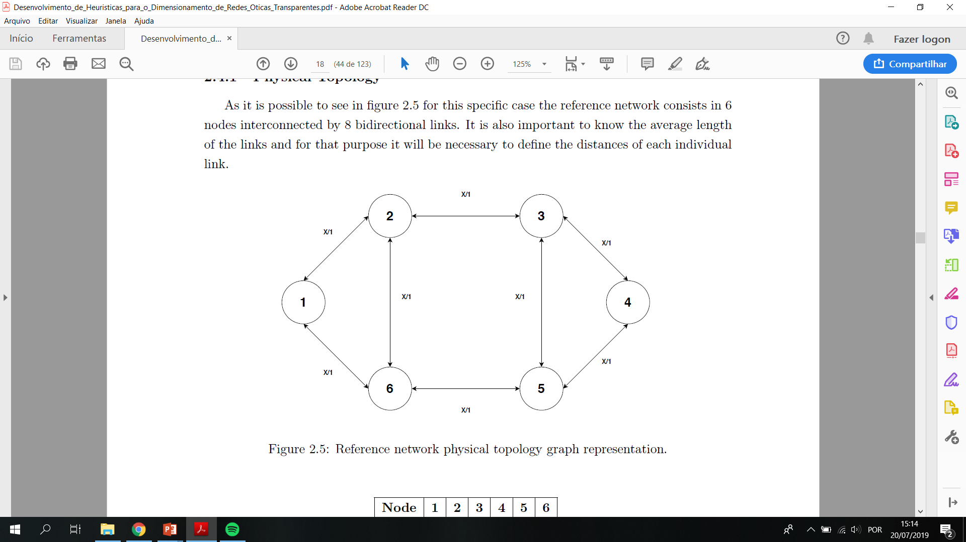
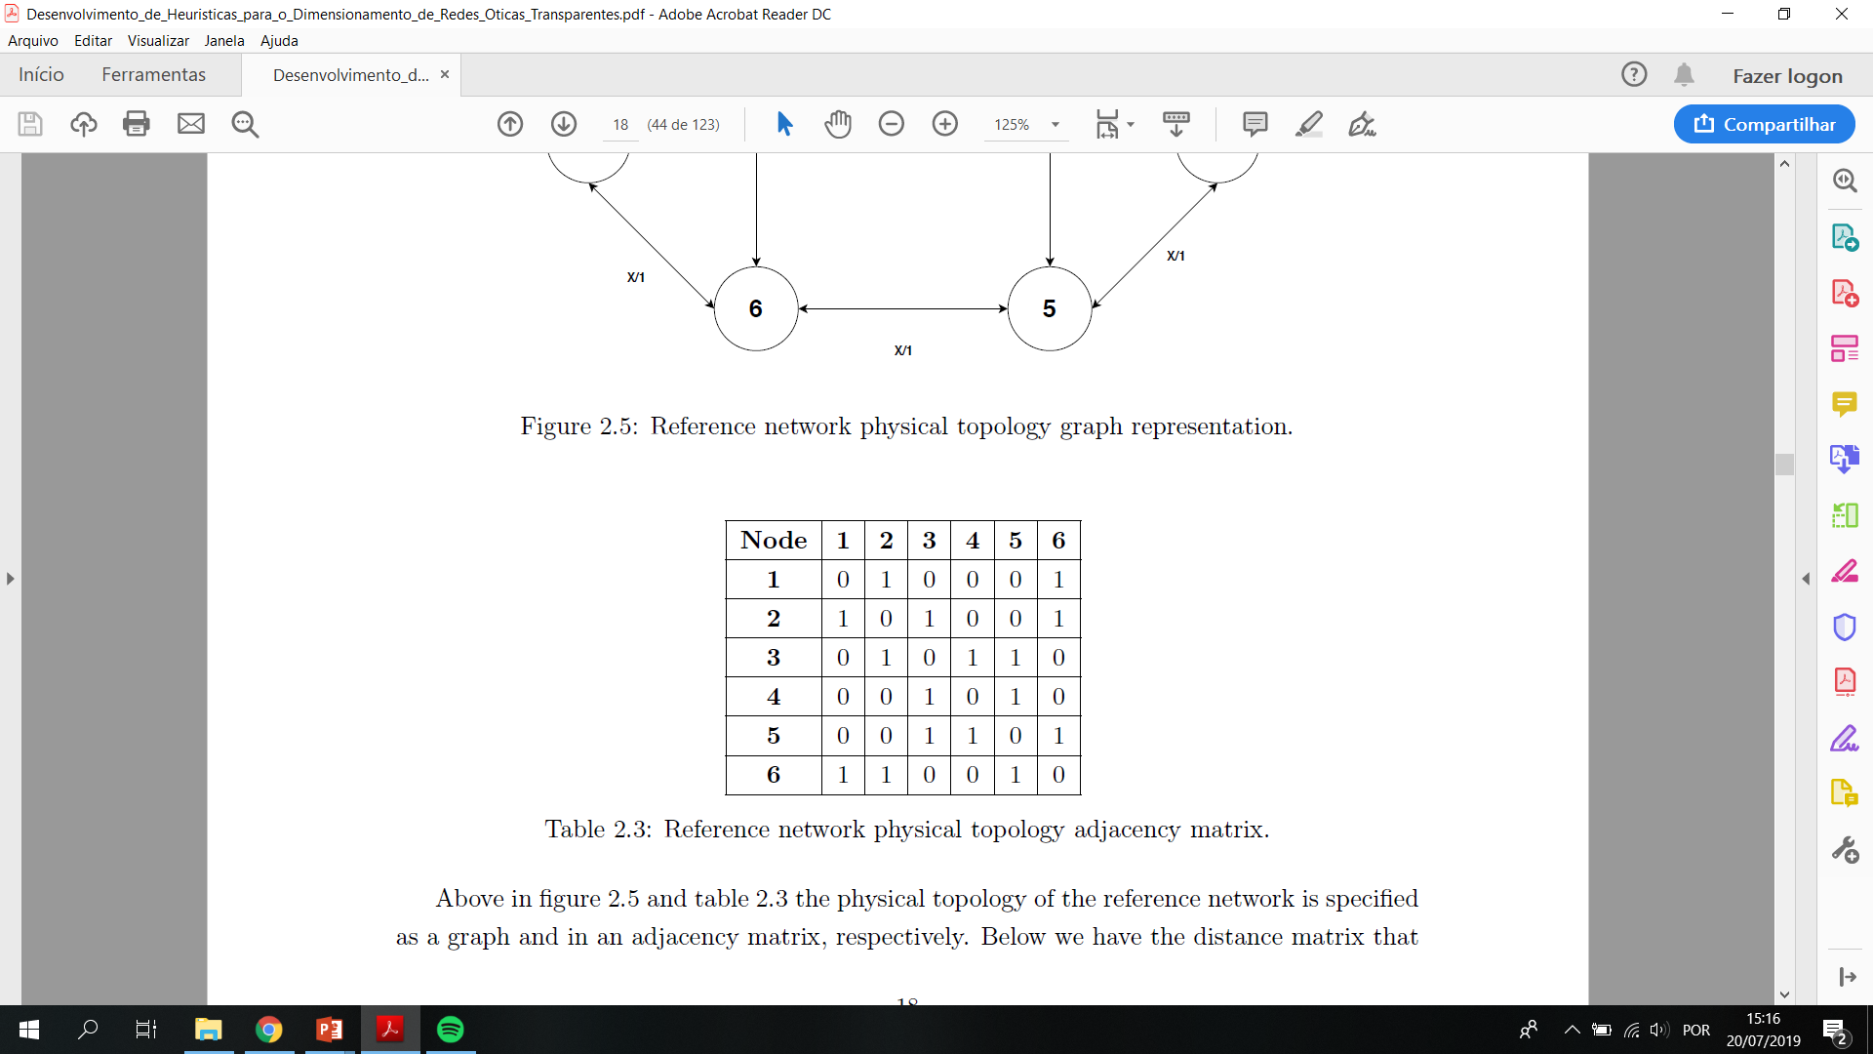
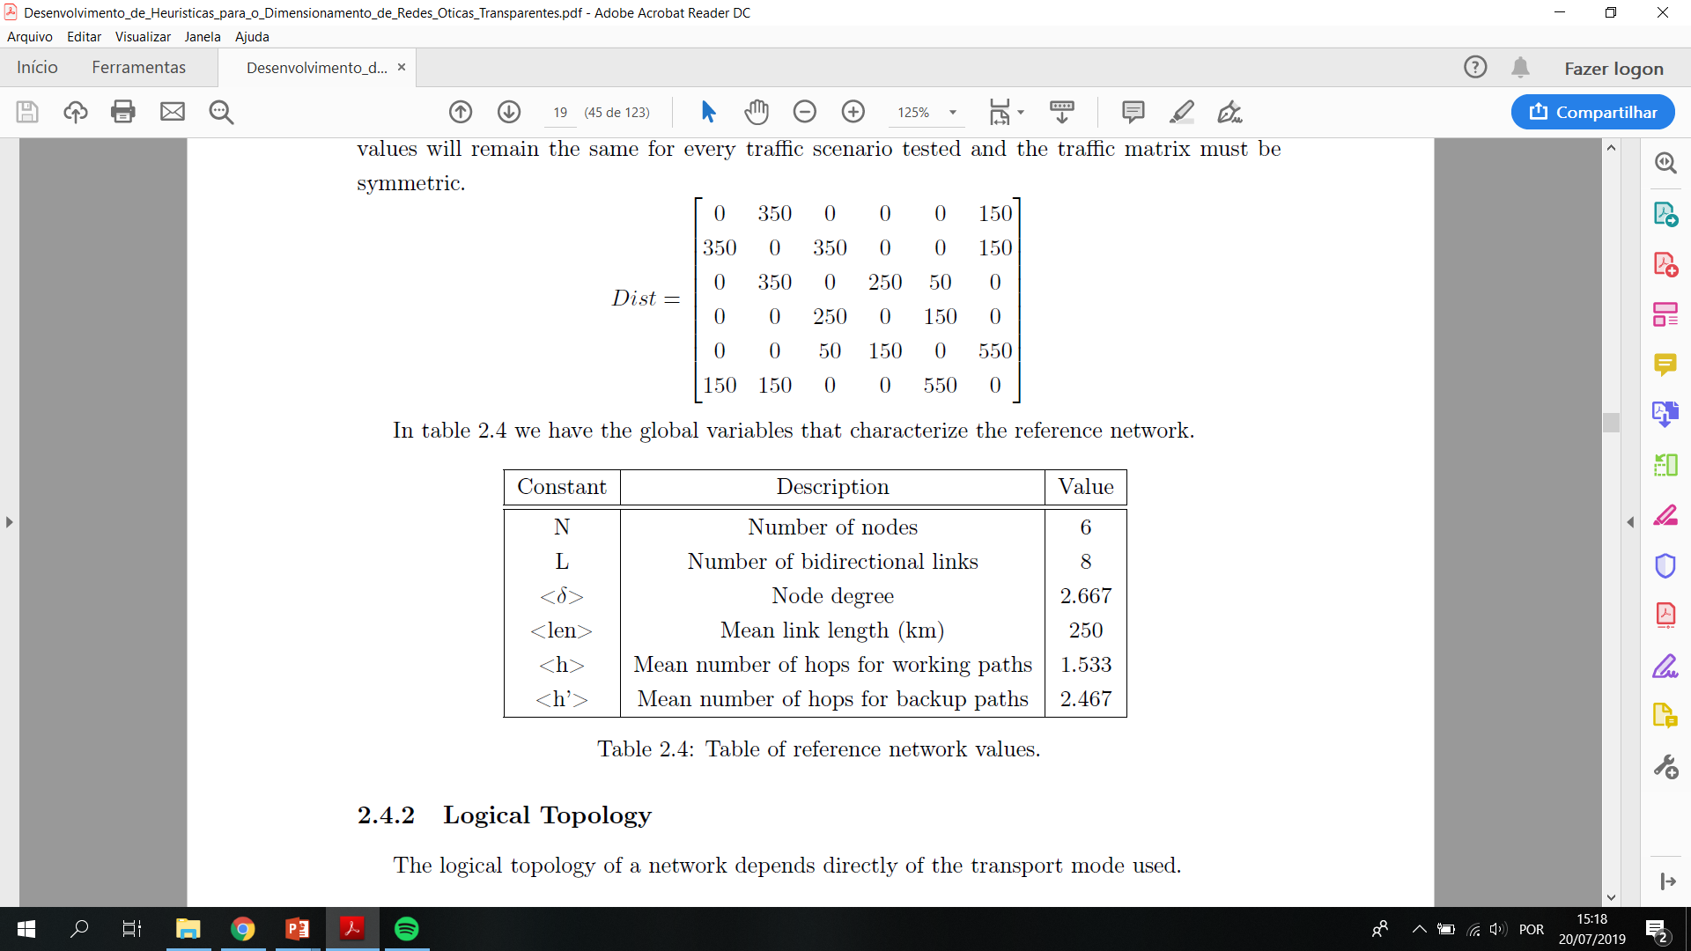
Reference Network
Development of Heuristics for Optical Transparent Networks Dimensioning

Slide 6
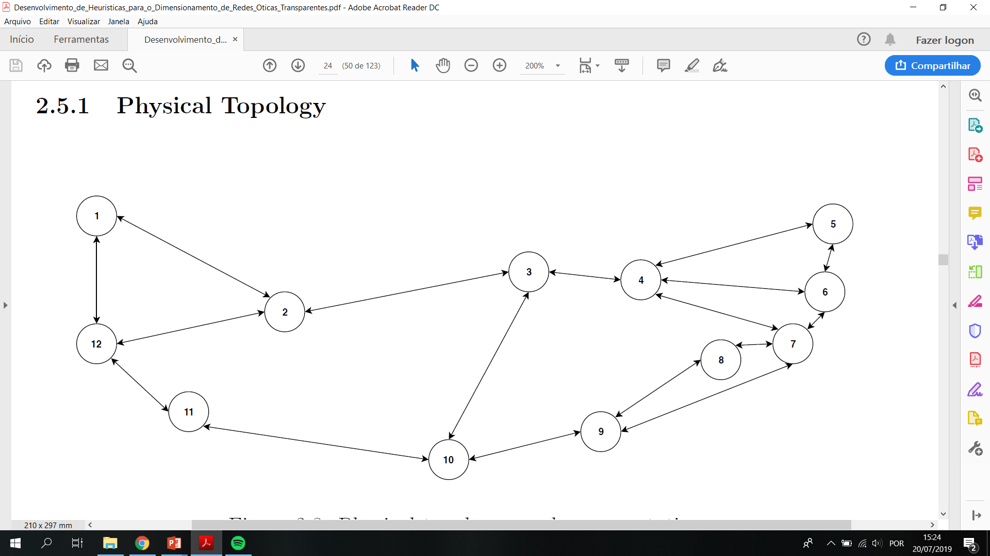
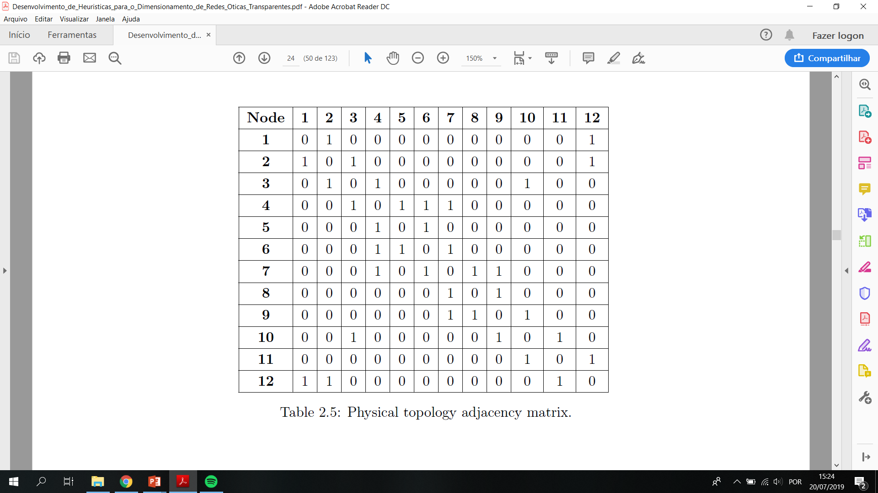
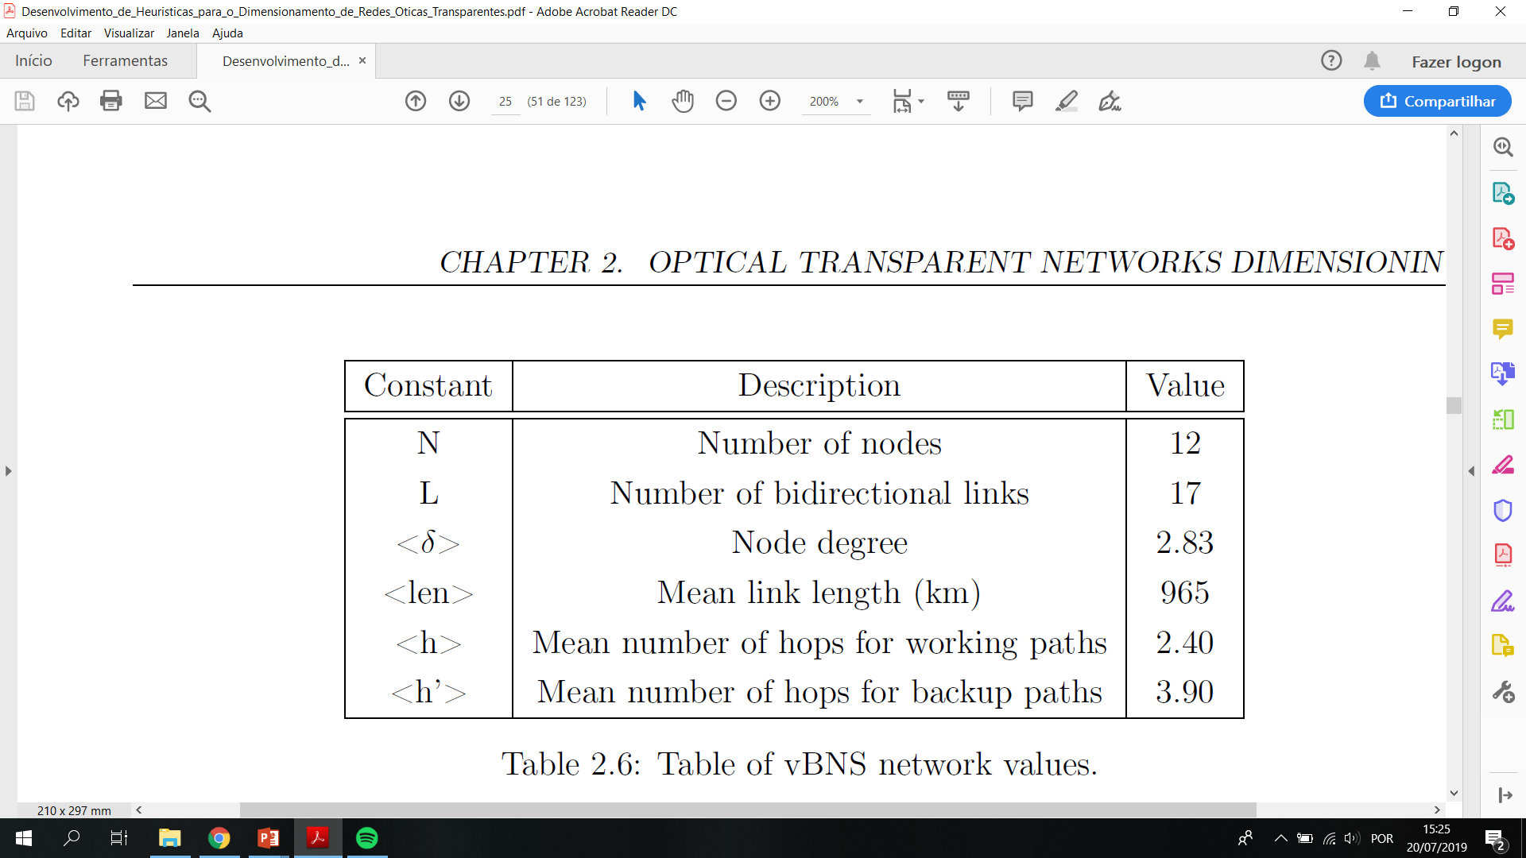
vBNS (very high-speed Backbone Network Service)
Development of Heuristics for Optical Transparent Networks Dimensioning

Slide 7
Logical Topology
Development of Heuristics for Optical Transparent Networks Dimensioning
Represents how the components of an optical network are connected.
Each node may be either optically connected to each other, or only optically connected to adjacent or suitable nodes, leading to a situation where different transport modes can exist.
It can also be represented as a graph or through adjacency matrices.

Slide 8
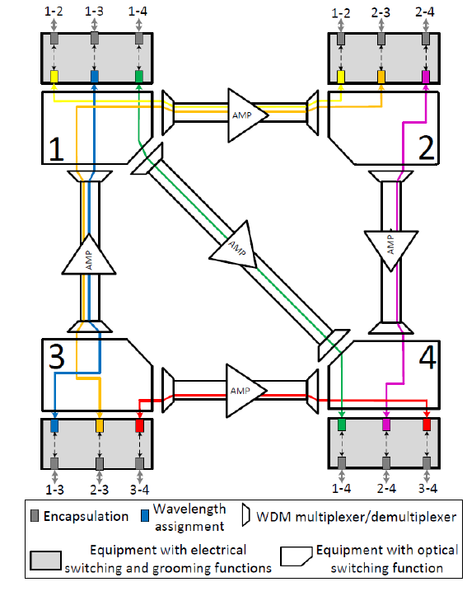
Transparent transport mode
Development of Heuristics for Optical Transparent Networks Dimensioning
Every node is optically connected to all others.
Signals remain in the optical domain from their source till the destination node.
A single-hop grooming scheme is used.
There is a wavelength continuity constraint.
The so called electro-optic bottleneck is eliminated.
Notes:
Single hop : as intermediate nodes do not perform wavelength conversions and so the requests must be assigned with the same wavelength on all the links of the used path
Wavelength constraint: implies that the utilization of the same wavelength channels is restricted to the client signals with the same endpoints
this method allows information transfer rates to reach closer values to those allowed by optical devices, which are significantly
beyond the rates achievable in an Optical-Electronic-Optical (O-E-O) network.

Slide 9
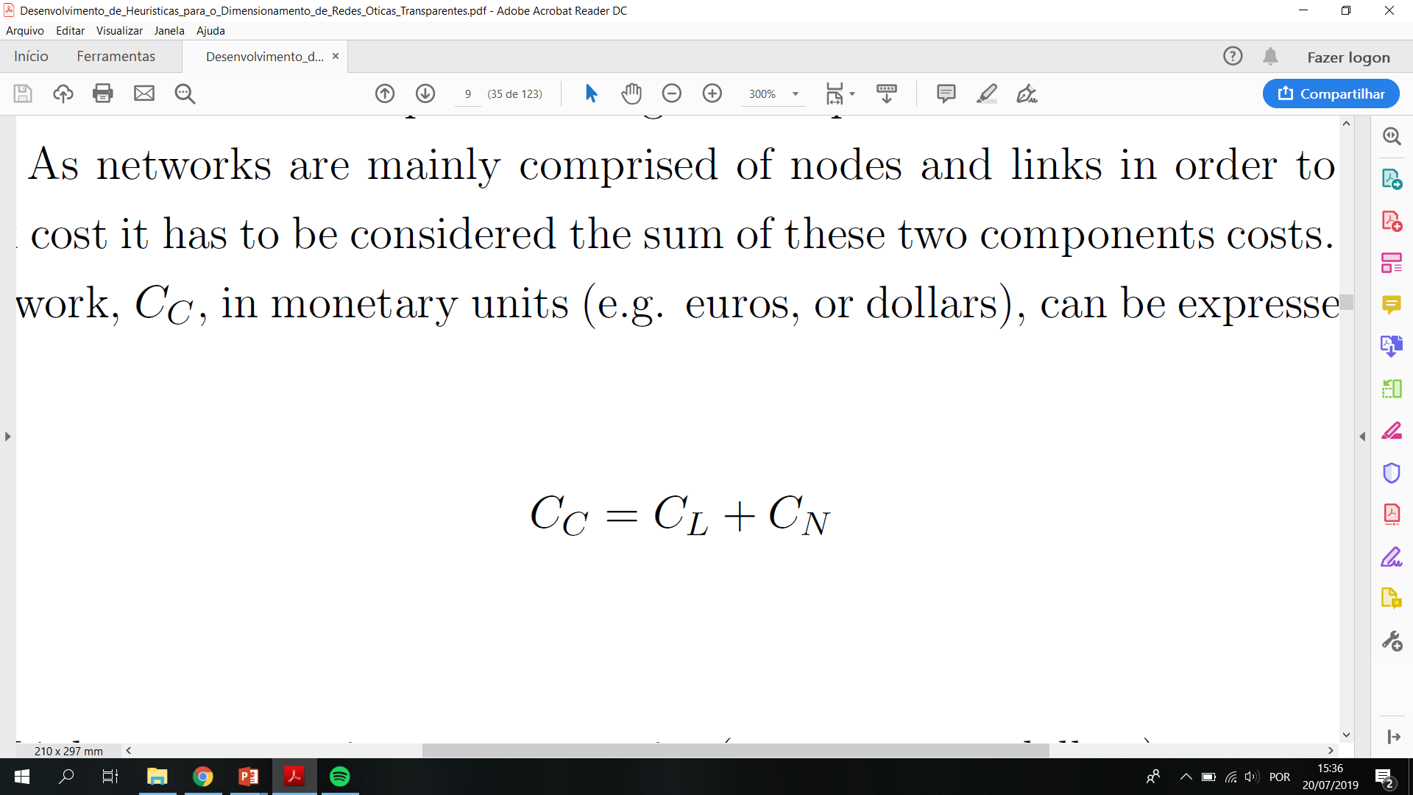
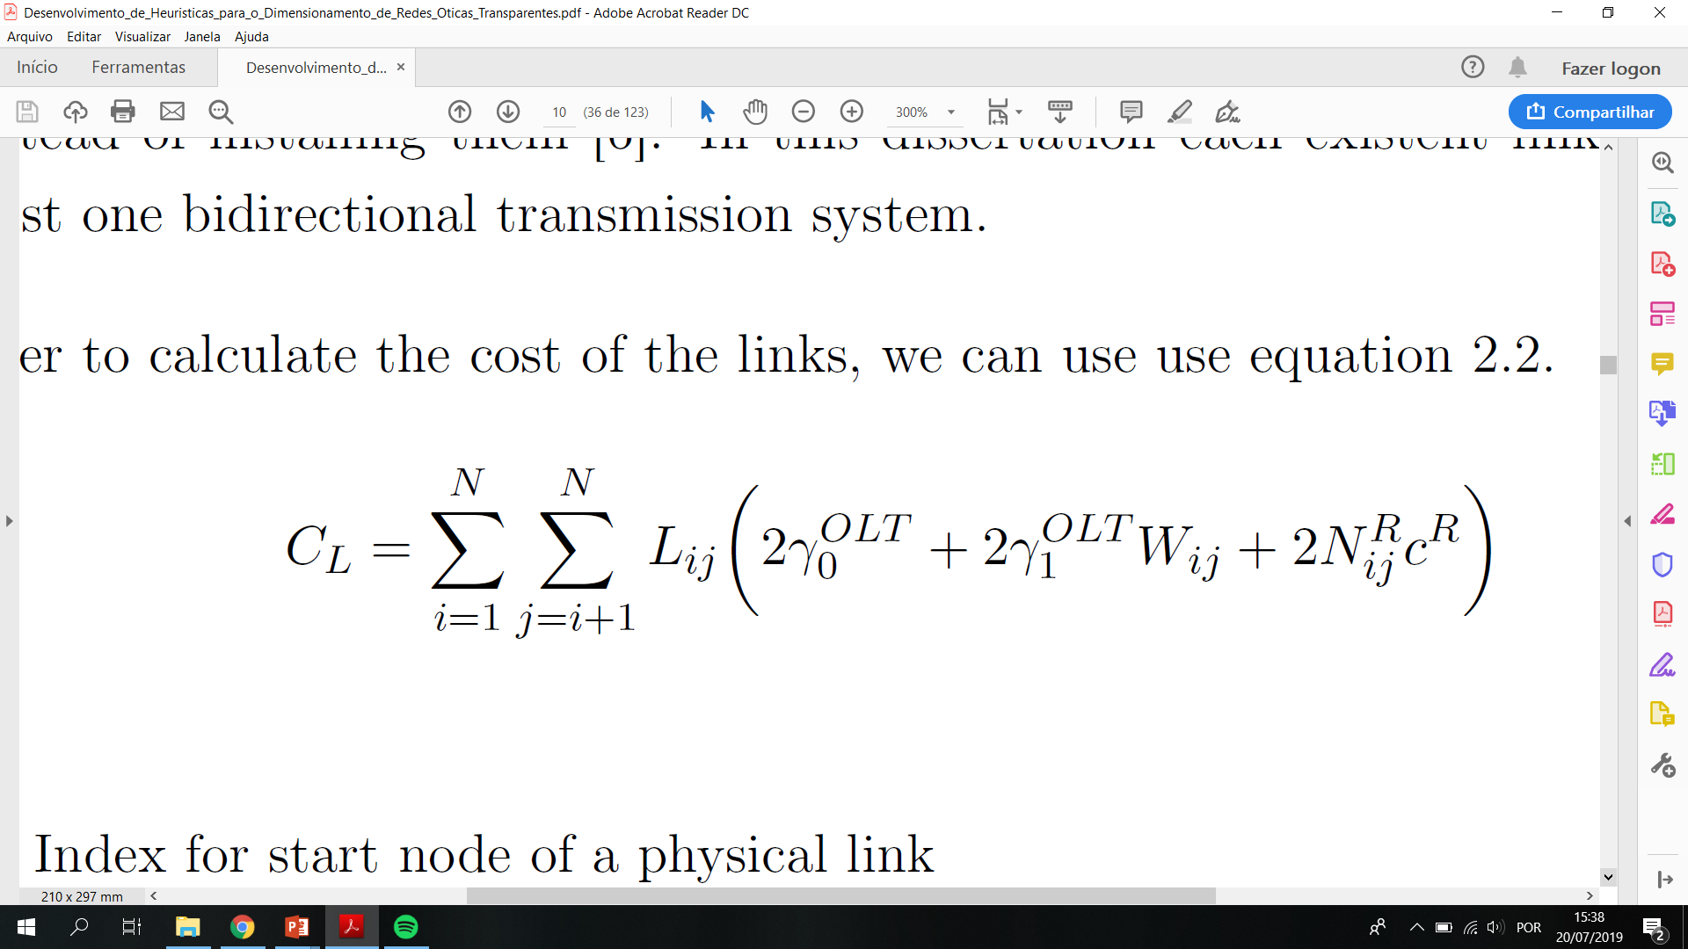
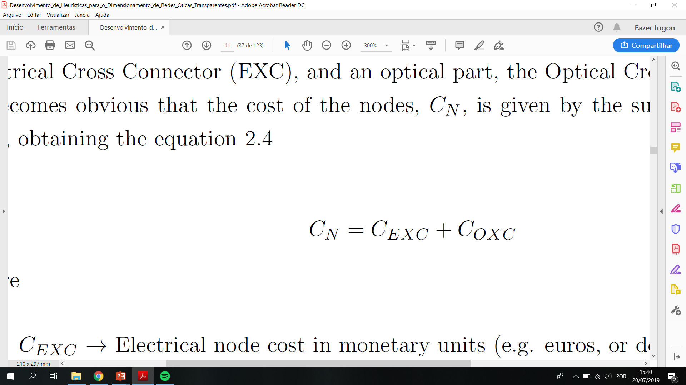
CAPEX Estimation
Development of Heuristics for Optical Transparentt Networks Dimensioning
Total network cost
Links part cost
Nodes part cost
Notes:
costs can be divided into two major branches: the
CAPEX and the OPEX. The first will be analyzed more closely during this dissertation and
can be sub-divided into the cost of buying and installing the equipment as well as setting up
the infrastructures and the second represents an expense a network company incurs through
its normal operations, which can include rent, inventory costs, insurance, and funds allocated
for research and development

Slide 10
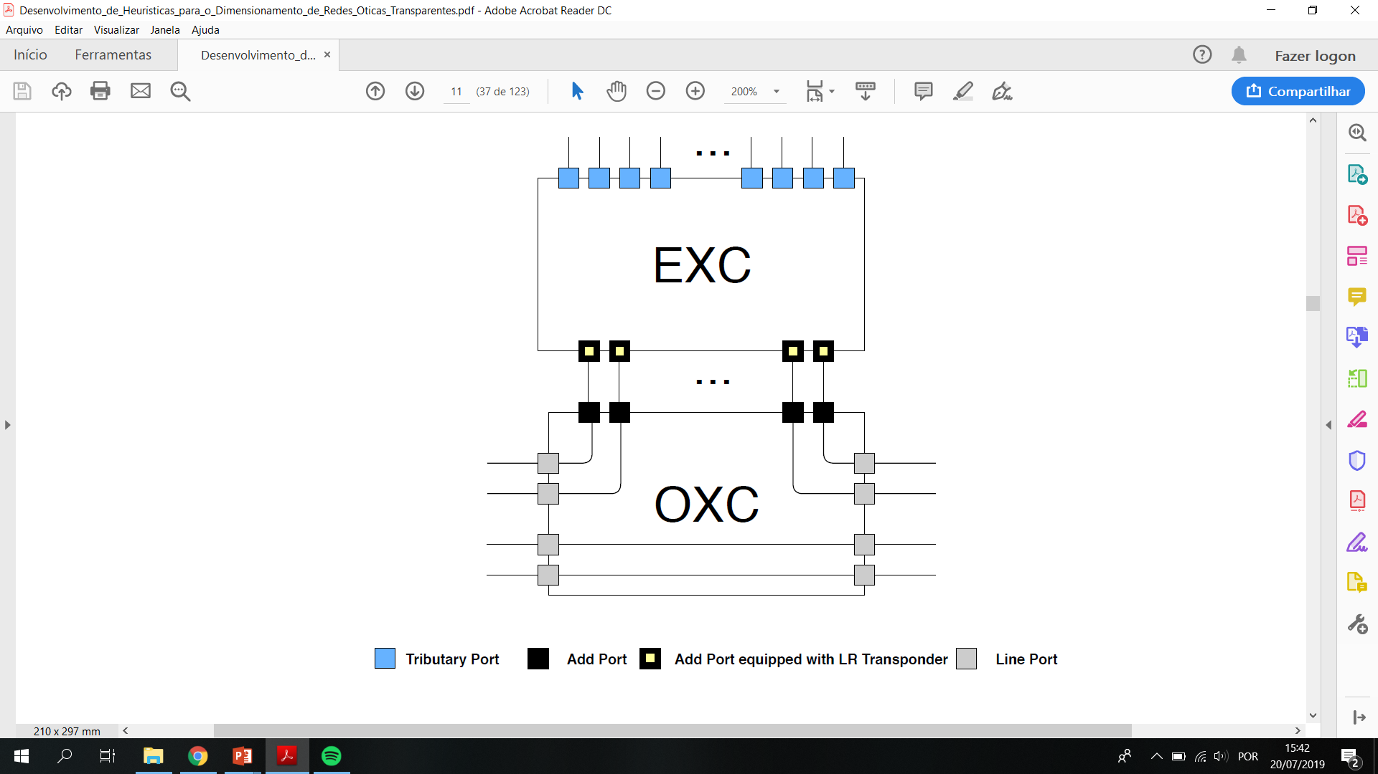
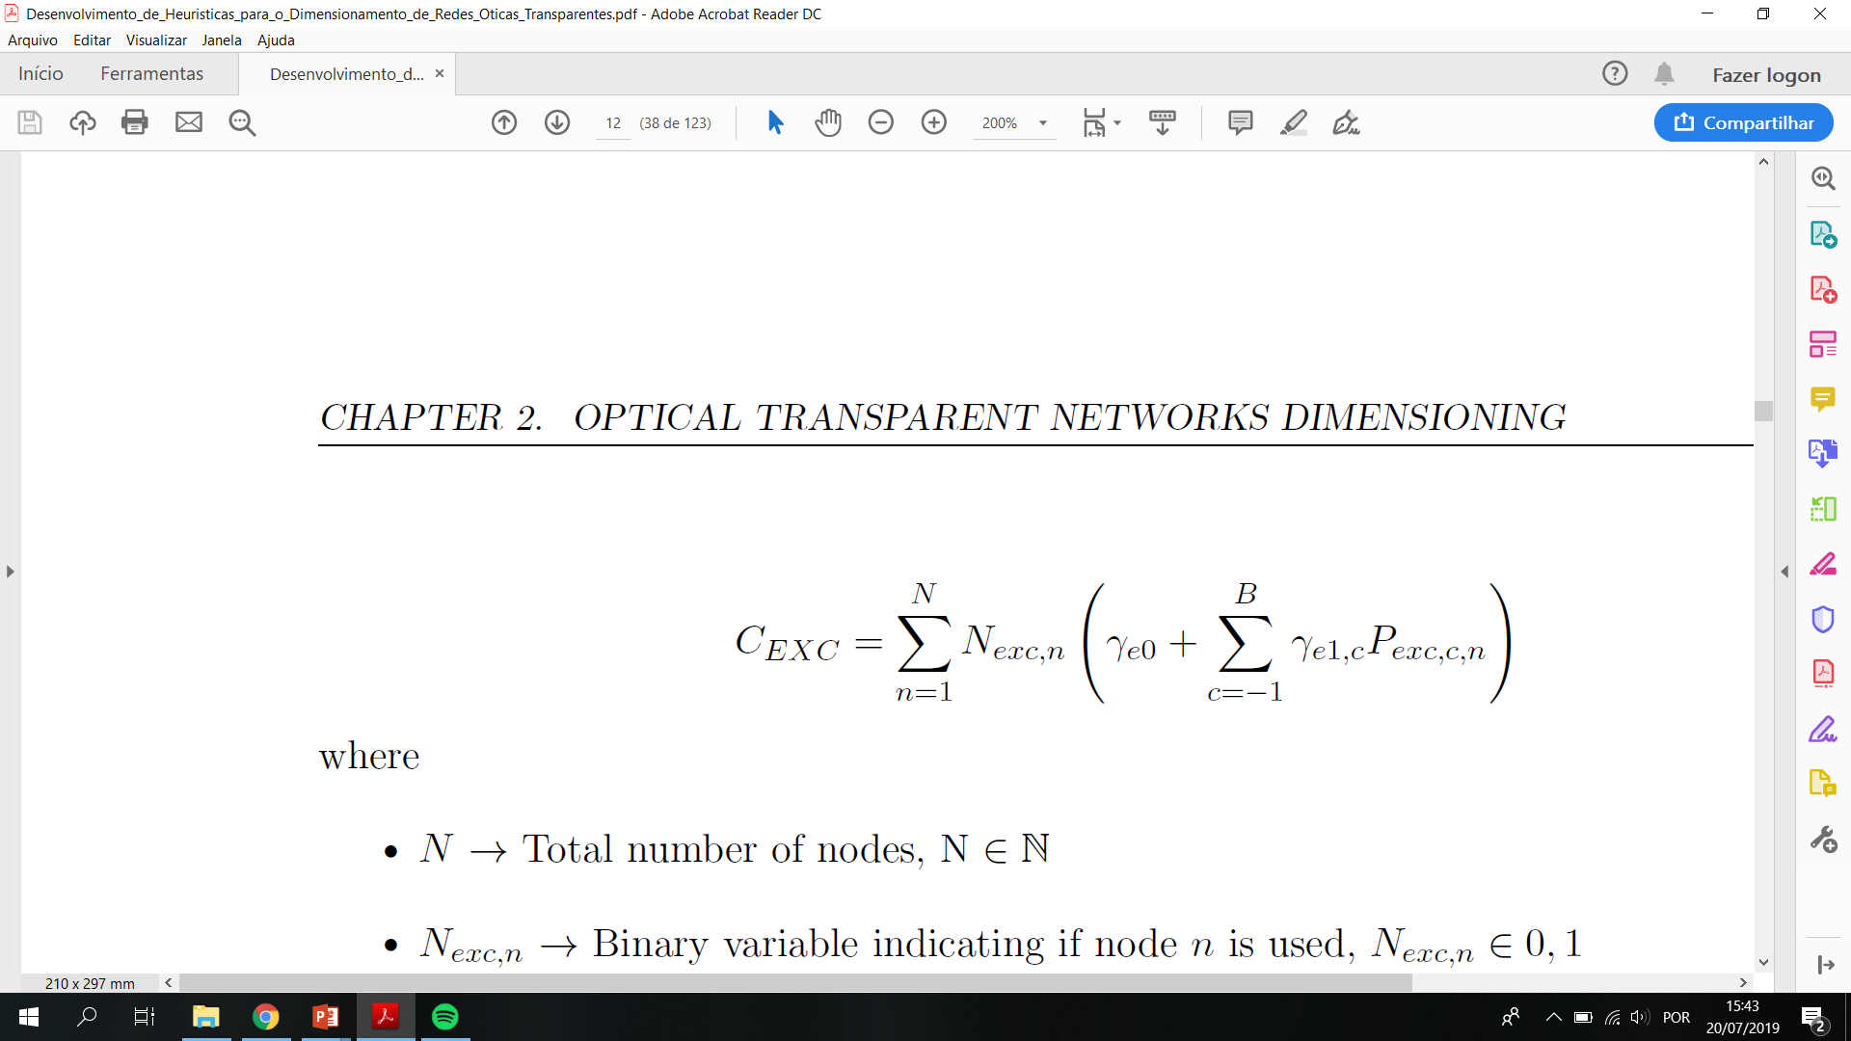
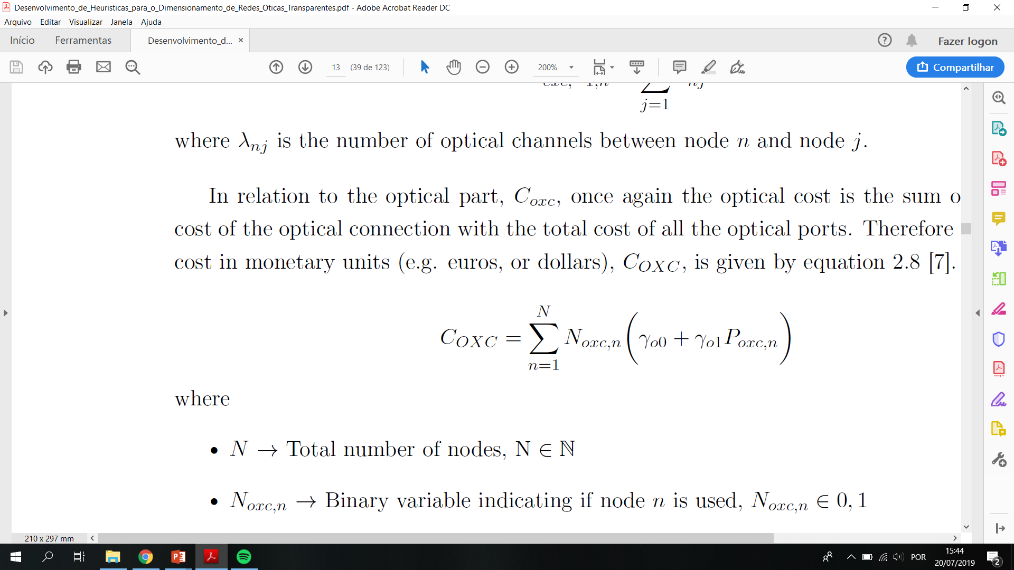
Development of Heuristics for Optical Transparent Networks Dimensioning

Slide 11
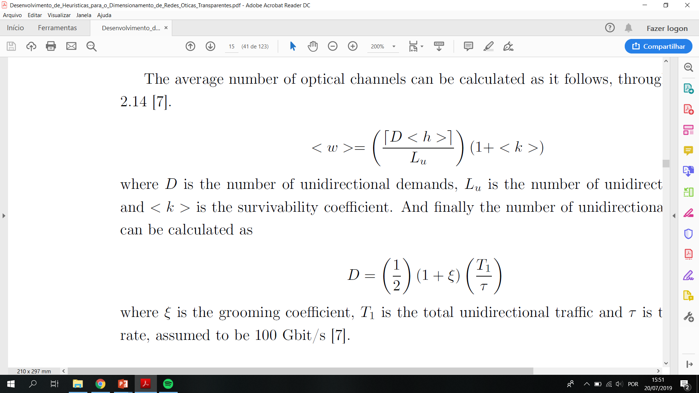
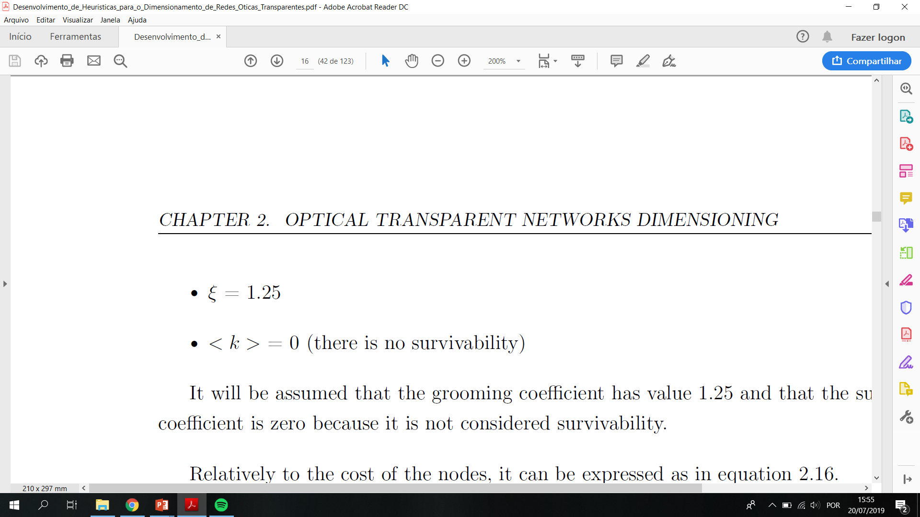
CAPEX Models
Development of Heuristics for Optical Transparent Networks Dimensioning
Analytical
Statistical approximation that do not provide exact and precise values.
Notes:
useful for cases where there is lack of some information, for example the number of demands to process or the topology of the network, or when the routing and/or grooming processes are unknown.
Epsilon: grooming coefficient
k: survivability coefficient

Slide 12
ILP (Integer Linear Programming)
Development of Heuristics for Optical Transparent Networks Dimensioning
Models that are usually applied into optimization problems, where a given function is intended to maximize or minimize, based on a set of constraints.
Provide optimal solutions.
Present poor scalability with complexity.

Slide 13
Heuristics
Development of Heuristics for Optical Transparent Networks Dimensioning
Heuristic algorithms are approaches designed for solving a given problem in a faster and more efficient fashion than traditional methods by trading optimality, accuracy, precision, or completeness for speed.

Slide 14
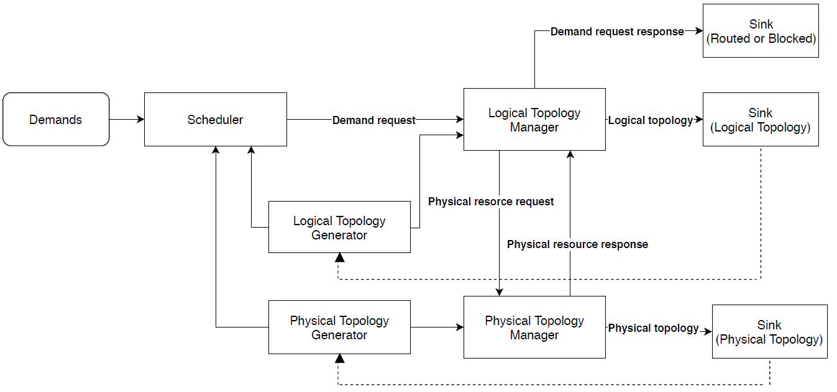
Generic Heuristics framework
Development of Heuristics for Optical Transparent Networks Dimensioning
The key role of framework is to permit developers to address only project relative needs rather than the low level phases of working systems.
Conceptual structure composed of a set of different layered entities which provide generic functionality while also being able to be selectively changed.
Serves as a support for the complex problem of dimensioning generic optical transport networks.
Notes:
It is a conceptual structure composed of a set of different layered entities which provide generic functionality while also being able to be selectively changed, thus enabling the possibility of future improvement by introducing new and more complex features and considerations of real worldwide networks.
When there is one or multiple traffic demands to be processed initially they must be sorted in a scheduler block, according to a predefined rule. Thereafter, the demands are sent one by one into a logical topology manager block where either an already existent capacity is used to route the demand or a request is made to create the capacity. That request is sent to a physical topology manager, where the information about the network physical links capacity is stored, and depending on the existence of remaining capacity, between other aspects, a response is given back to the logical topology manager regarding the possibility or not to route the demand. Finally, the useful information contained on the logical and physical manager blocks, as well as the information regarding the status of each processed demand, can be stored in sink blocks also presented in the diagram above.

Slide 15
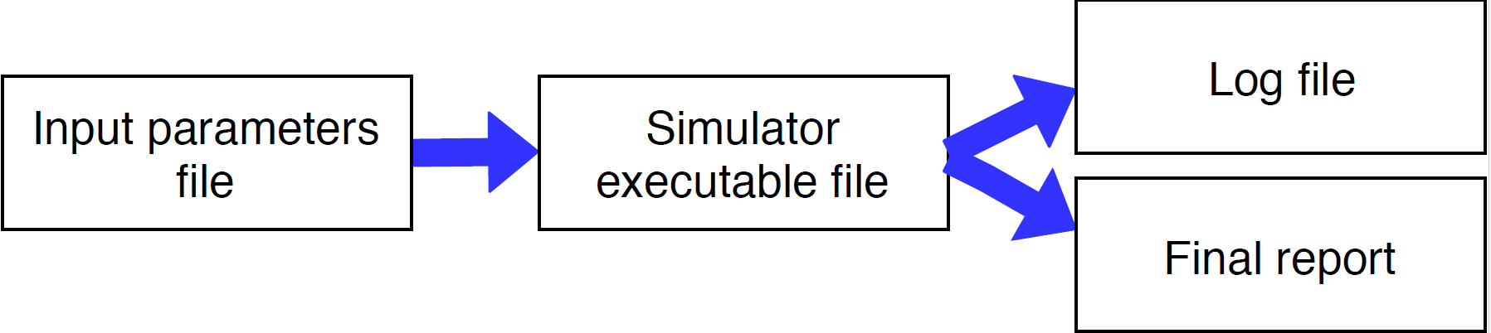
NetXPTO implementation
Development of Heuristics for Optical Transparent Networks Dimensioning
The framework previously mentioned was implemented over the NetXPTO open source simulator, a real-time simulator that allows the creation of generic systems comprised of a set of blocks interacting with each other through signals.
Notes:
The executable file is generated upon the compilation of the project.
The Log File allows for a detailed analysis of a simulation. It will output a file named log.txt containing the timestamp of when a block is initialized, the number of samples in the buffer ready to be processed for each input signal, the signal buffer space for each output signal and the amount of time in seconds that took to run each block. This will occur in each and every cycle until the system terminates the simulation.
After running a simulation a text file named FinalReport.txt is generated, in the same directory of the project, containing the final results. Detailed information regarding the network nodes and links constitution, a routing scheme of the demands processed and the final CAPEX values obtained for the network are presented in this file.

Slide 16
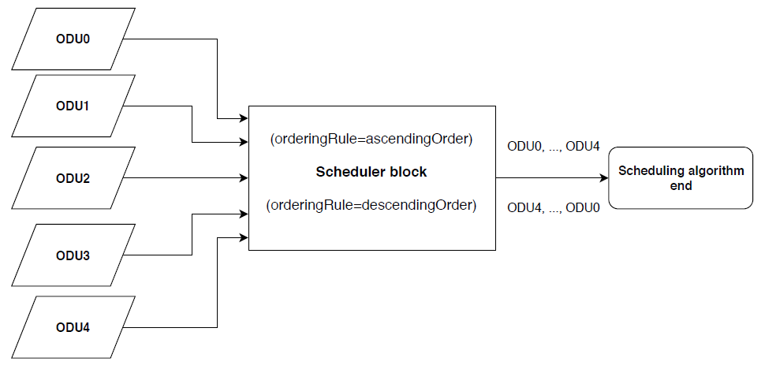
Heuristic algorithms (Scheduling)
Development of Heuristics for Optical Transparent Networks Dimensioning
Possible metrics may include:
Quantity of traffic of each individual request;
Traffic granularity;
Length of the shortest logical or physical paths (distance or hops);
Need for protection.
Notes:
Or a smart combination of some of this aspects.
The chosen criteria for test performing purposes was the descending ordering rule since demands that require bigger bandwidths become harder to accommodate and thus should be the first ones to be processed in order to guarantee the assignment of the optimal paths.
It is assumed that although multiple demands can be added at once till the network, each demand is processed individually before moving on to the next.

Slide 17
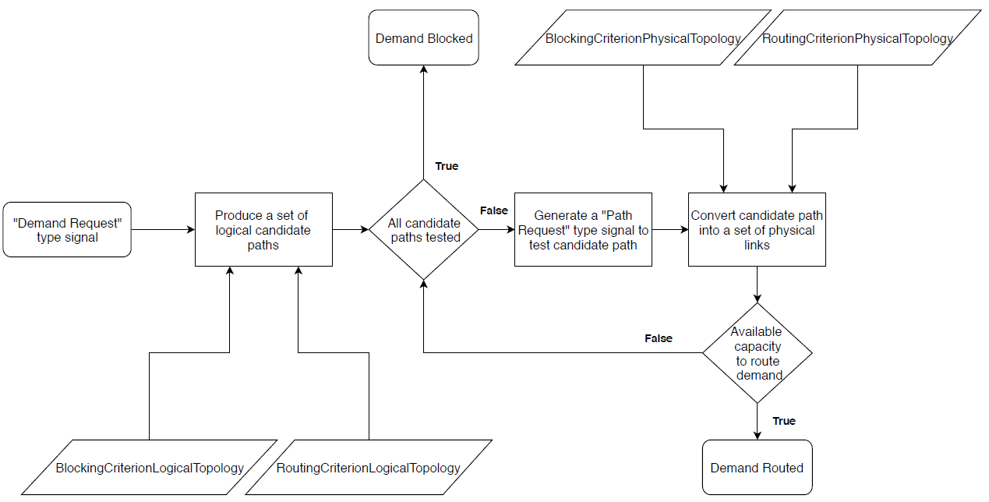
Routing
Development of Heuristics for Optical Transparent Networks Dimensioning
In order to produce a set of paths the routing strategy applied incorporates the use of a K-shortest path algorithm, based on Dijkstra’s algorithm;
The number of hops was chosen as the metric to find the shortest paths;
In order to select a candidate path it was used a dynamic-path routing strategy, once it provides adaptability to network conditions;
A poor routing strategy can lead to a situation of wavelength contention provoking the loss of network efficiency as demands are blocked.

Slide 18
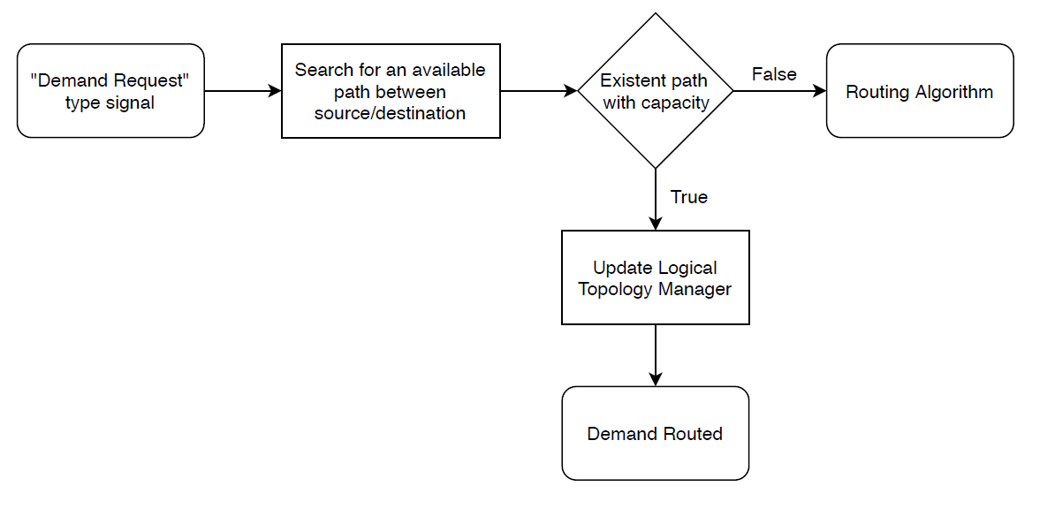
Grooming
Development of Heuristics for Optical Transparent Networks Dimensioning
Process of aggregating sub line-rate traffic in order to diminish the percentage of wasted wavelength capacity, making networks more efficient.
In transparent networks the type of grooming performed is called end-to-end multiplexing.
Demands may only ride together if the pair of source and destination nodes is the same.
Notes:
Grooming é um processo que permite agregar pedidos de tráfego com capacidade inferior ao tráfego de linha, de maneira a minimizar a largura de banda desperdiçada.
In transparent networks the type of grooming performed
is called end-to-end multiplexing, where traffic demands are packed into wavelengths and
processed as a single unit from source to destination. In this transport mode demands may
only ride together if the pair of source and destination nodes is the same.

Slide 19
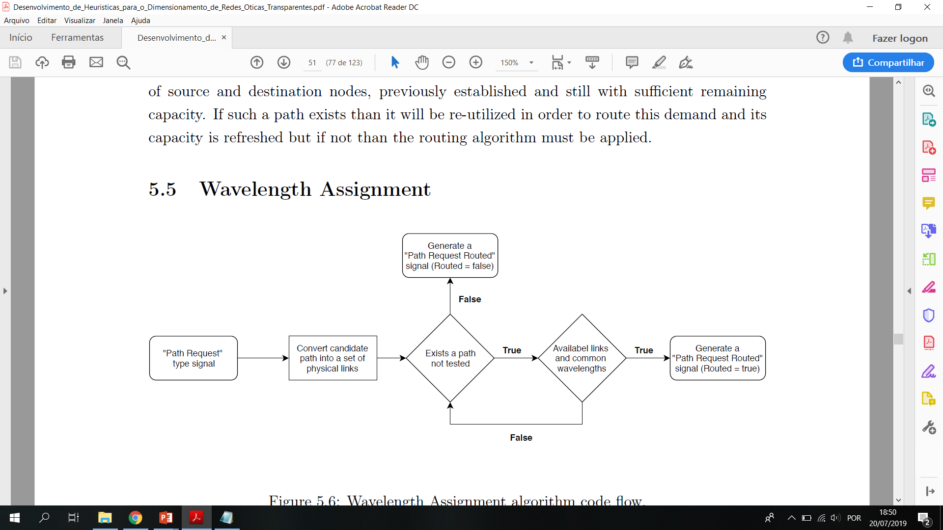
Wavelength assignment
Development of Heuristics for Optical Transparent Networks Dimensioning
Transparent networks require wavelength continuity in all nodes from source to the destination.
O-E-O conversions are only performed in end nodes.
Follows the routing process.
The strategy adopted in order to assign wavelengths is commonly known as First-Fit.
Notes:
This is one crucial step in transparent networks planning once they require wavelength
continuity in all nodes from source to the destination, meaning that signals entering a source
node are kept in the optical domain at every intermediate nodes of the path until reaching its
destination

Slide 20
Results
Development of Heuristics for Optical Transparent Networks Dimensioning
In order to perform some tests on the networks specified above, different traffic scenarios were designed. The different traffic scenarios may contain ODU0 (1.25 Gbit/s), ODU1 (2.5 Gbit/s), ODU2 (10 Gbit/s), ODU3 (40 Gbit/s) and ODU4 (100 Gbit/s) demand requests.
Reference network
Low Traffic (1 Tbit/s)
Medium Traffic (5 Tbit/s)
Realistic network
Medium-High Traffic (7.5 Tbit/s)
High Traffic (10 Tbit/s)
Notes:
De modo a podermos testar as heuristicas desenvolvidas foram desenhados 3 diferentes cenários de tráfego para a rede de referência. Após a validação das heuristicas com os resultados obtidos para a rede de referência, uma rede muito simples, os vários modelos foram aplicados a uma rede real, mais complexa, de maneira a poder perceber quais as vantagens que estes algoritmos poderam trazer na análise de situações mais reais e complexas.
Uma ODU é a unidade básica de transporte que pode sofrer grooming e switching a nivel electronico dentro de uma rede OTN.

Slide 21
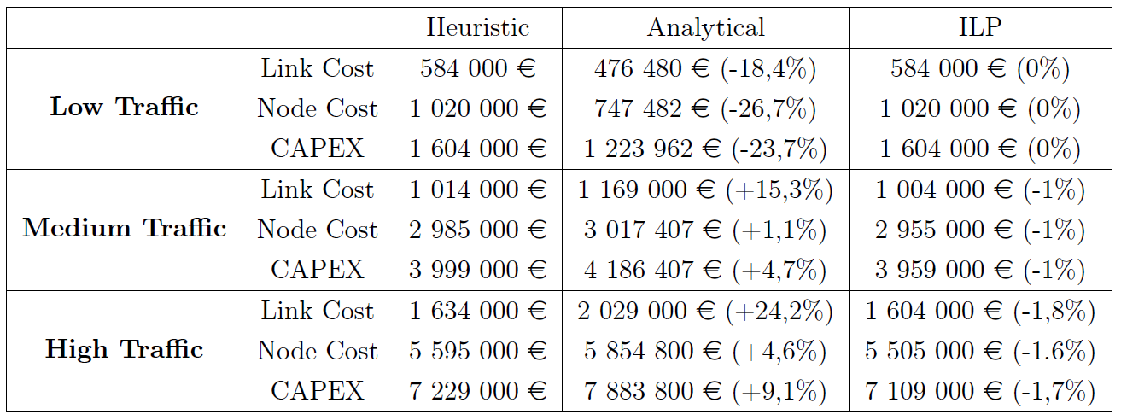
Reference network
Development of Heuristics for Optical Tranparent Networks Dimensioning
Economic comparative analysis
Notes:
Tal como esperado os valores de CAPEX obtidos pelas heuristicas foram ligeiramente piores comparando com os ILPs, para as situções mais complexas de médio e alto tráfego mantendo se a margem de erro nos 1% e 1,7% respectivamente, no entanto para a situação de baixo tráfego os valores obtidos foram idênticos. Outra coisa não poderia ser esperada uma vez que o propósito das heurísticas é o de descobrir a solução ótima para um problema dentro do conjunto de possíveis soluções. No entanto essa solução pode não ser a melhor, devido à limitação destes algoritmos, posto isto só podemos confirmar que o resultado é ótimo após compará lo com os resultos dados pelo modelo ILP. Relativamente aos resultados dados pelo modelo analitico, foram verificadas elevadas variações tanto para baixo como para cima em relação às soluções supostamente ótimas. Isto acontece pois este método trabalha com valores médios fixos neste caso o coeficiente de grooming, ao contrário do que acontece com o modelo ILP e heuristic onde este coeficiente varia de acordo com a quantidade de tráfego processado. No caso de baixo tráfego o enorme erro relativamento à solução ótima (23,7%) fica a dever se ao facto de o coeficiente de grooming assumir um valor bastante mais elevado para os modelos ILP e heuristic pela existência de pouco tráfego.
Uma vez que é prática comum o uso de modelos heuristicos em redes simples para que possam ser calibrados e tendo em conta os resultados de CAPEX obtidos Podemos considerer que os algoritmos desenvolvidos estão bem calibrados.

Slide 22
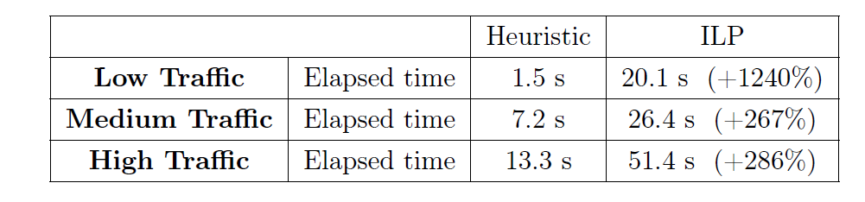
Development of Heuristics for Optical Transparent Networks Dimensioning
Time of execution comparative analysis
Notes:
O trade-off existente entre este dois processos é o de tempo por precisão. Enquanto que usualmente os modelos ILPs proporcionam soluções ótimas para problemas de otimização o tempo de execução deste modelos matemáticos pode durar horas, dias ou até mesmo semanas dependendo da complexidade do problema em mãos. Por outro lado os algoritmos heuristicos proporcionam soluções muitas vezes suficientemente próximas da ideal normalmente em questão de segundos ou minutos. Dito isto os resultados obtidos nesta vão de encontro ao esperado uma vez que mesmo para situações mais simples os algoritmos heuristicos são bastante mais rápidos a obter soluções para o problema. Isto poderá explicar se pelo baixo nivel de complexidade das heuristicas desenvolvidas e aplicadas nesta dissertação umas vez que elas limitam severamente o conjunto de possiveis soluçoes.

Slide 23
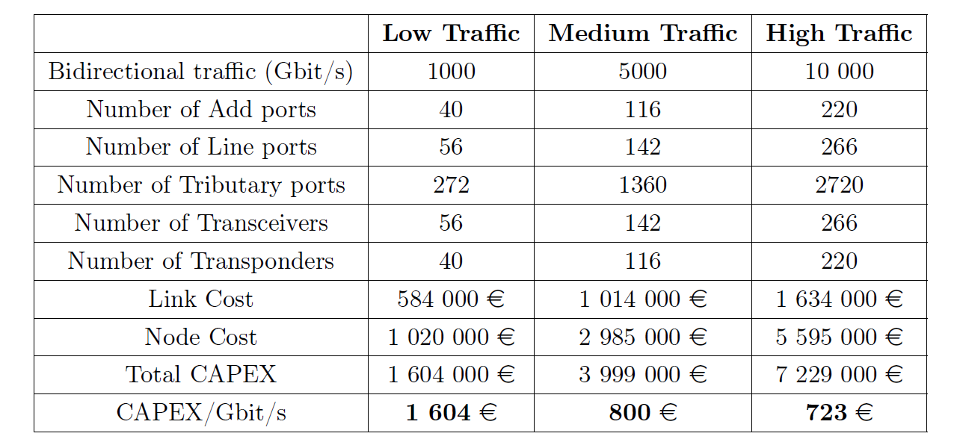
Development of Heuristics for Optical Transparent Networks Dimensioning
Brief Techno-Economical Analysis (Heuristic model)
Notes:
After the validation of the heuristic results a more careful and detailed analysis can now be done.
De acordo com os resultados obtidos pelo modelo heuristic para a rede de referência verificou se que o custo monetário por Gbit/s decresce bastante com o aumento de tráfego processado pela rede, sendo esta diferença mais acentudada do cenário de baixo tráfego para o de médio tráfego. Isto demonstra que quanto maior for a quantidade de tráfego maior vai ser a capacidade da rede para agregar o tráfego de uma forma mais eficiente, minimizando assim a percentage de largura de banda desperdiçada. Para além disto outra hipótese poderá residir no facto de que com o aumento do trafego algum dos equipamentos existentes na rede não terem de ser acrescidos, por exemplo com o aumento do tráfego um amplificador ótico cuja capacidade não esteja a ser usada em toda a sua extensão poderá passar a a estar à medida que por ele passam mais canais óticos não havendo o aumento da quantidade de componentes fazendo com que o preço por bit diminua.

Slide 24
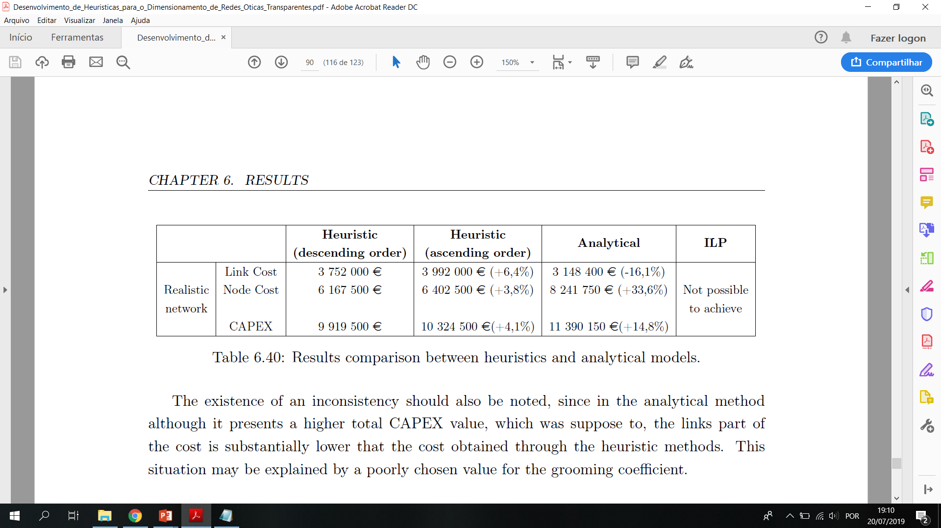
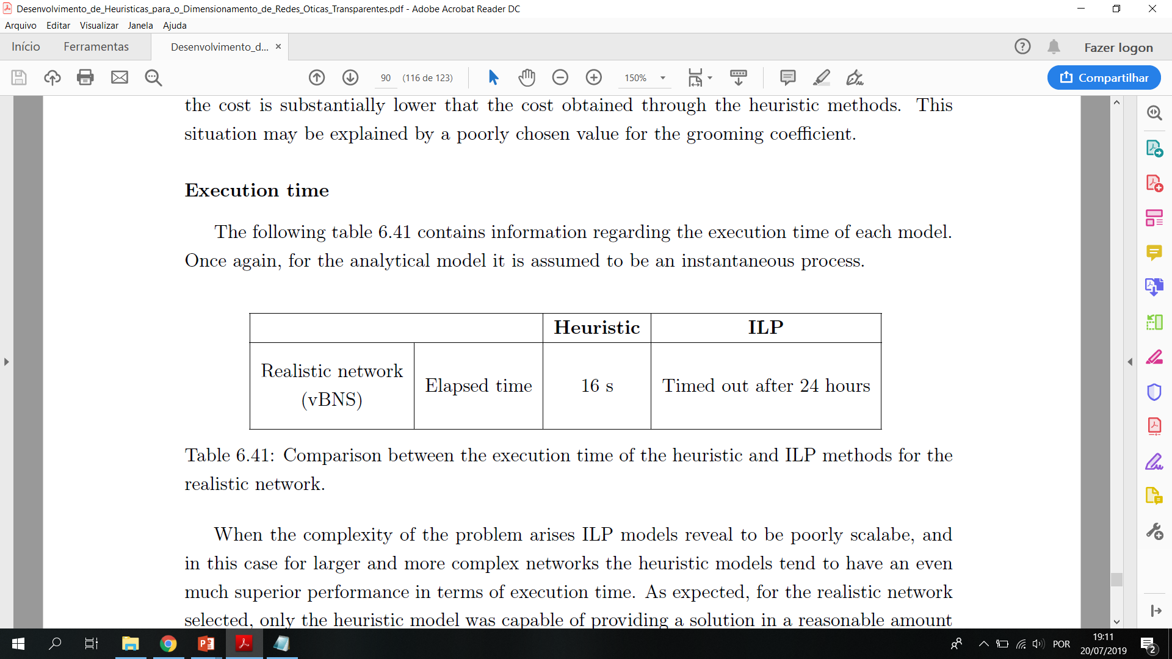
Realistic network (vBNS)
Development of Heuristics for Optical Transparent Networks Dimensioning
Economic comparative analysis
Time of execution comparative analysis
Notes:
Relativamente à rede realista, todos os três modelos foram novamente aplicados e para o caso particular das heuristicas ao nivel do algoritmo de scheduling foram usadas ambas as possiveis ordens de processamento de tráfego. Tal como esperado para uma rede real e mais complexa as nossas heuristicas apresentam soluçoes largamente superiores aos resultados provenientes do modelo analitico. Para além disso a ordem descendente de processamento de tráfego (começando pelas ODU maiores até às mais pequenas) parece favorecer estratégias de routing e grooming mais eficientes. A ideia passa por processar primeiro os pedidos maiores pois estes sao mais dificeis de encaixar, de modo a garantir a atribuição de caminhos otimos a todos os pedidos de trafego. Relativamente aos ILPs nenhum resultado foi obtido durante as 24 horas de prazo máximo estabelecido, assim sendo confirma se que estes metodos são pouco escalaveis com o aumento da complexidade dos problemas (devido ao aumento exponencial do conjunto de possiveis soluçoes) e portanto verifica se que as heuristicas são essencias para o planeamento e dimensionamento de redes reais.

Slide 25
Conclusions
Development of Heuristics for Optical Transparent Networks Dimensioning
The analytical values showed higher fluctuations, for the reference network, once the grooming coefficient value is initially defined and fixed for every scenario but in the case of the ILP or the heuristic models the coefficients vary according to the traffic processed.
The heuristics applied were well calibrated since the margin of error towards the ILP results was minimal, for the reference network, under 2% for the medium and high traffic scenarios, or even nonexistent for the low traffic scenario.
For the realistic network only the heuristic algorithms were capable of providing a solution in a reasonable amount of time, while the ILP model was not capable of encountering the solution under a maximum defined timeout period of 24 hours.
Heuristic algorithms may be a good solution for real and more complex problems considering that the ILP models for these cases take a long time to obtain results.
Notes:
which means that for simpler cases the heuristics performance can match the ILPs
thus, once again showing that these algorithms may be a good solution for real and more complex problems considering that the ILP models for these cases take a long time to obtain results.

Slide 26
Thank you!
Development of Heuristics for Optical Transparent Networks Dimensioning

